Slide 1
Technology-based approach for the treatment and recovery management of alcohol abuse
By
Anubhav gupta
Birwa Galia
Milony mehta

Slide 2
Introduction
The models used by alcohol and substance abuse facilities do not provide the activities required to correct the issues of alcohol and substance abuse.
There is urgent need to provide society with appropriate facilities which can detect and give treatments that can cure people suffering from any kind of addiction.
Digitize the real time interaction between a patient and a doctor.
Application to help doctor to detect proper treatments for people suffering from alcohol addiction

Slide 3
Approach
The app has a questionnaire which helps doctor to evaluate the level of alcohol addiction in the patient.
This questionnaire is based on The Alcohol Use Disorders Identification Test (AUDIT).
Adapted with permission from Saunders JB, Aasland OG, Babor TF, de al Fuente JR, Grant M. Development of the Alcohol Use Disorders Identification Test (AUDIT): WHO Collaborative Project On Early Detection Of Persons With Harmful Alcohol Consumption—II. Addiction 1993;88:791–804.
Taking into consideration the questionnaire, the score is calculated and accordingly a zone is assigned which results in the treatmennnt recommendations provided by the doctor.

Slide 4
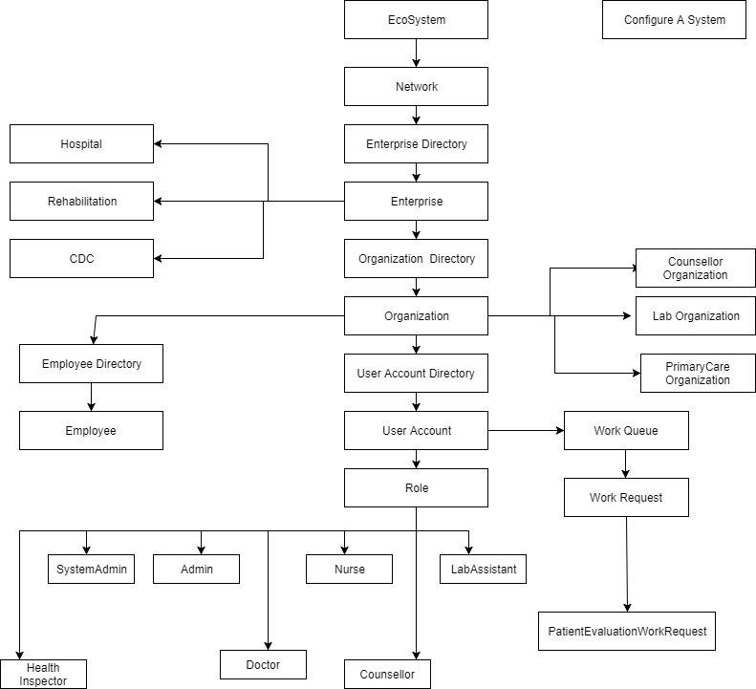
Object Model

Slide 5
Use Cases
System with hierarchy and authorization
Patient Assessment
Doctor Assessment for Patient
Lab Test Assessment for patient
Recommendations provided by doctor
Keeping track of patient history
Counselor Assessment for Patient
Report Generation at System Level and Network Level

Slide 6
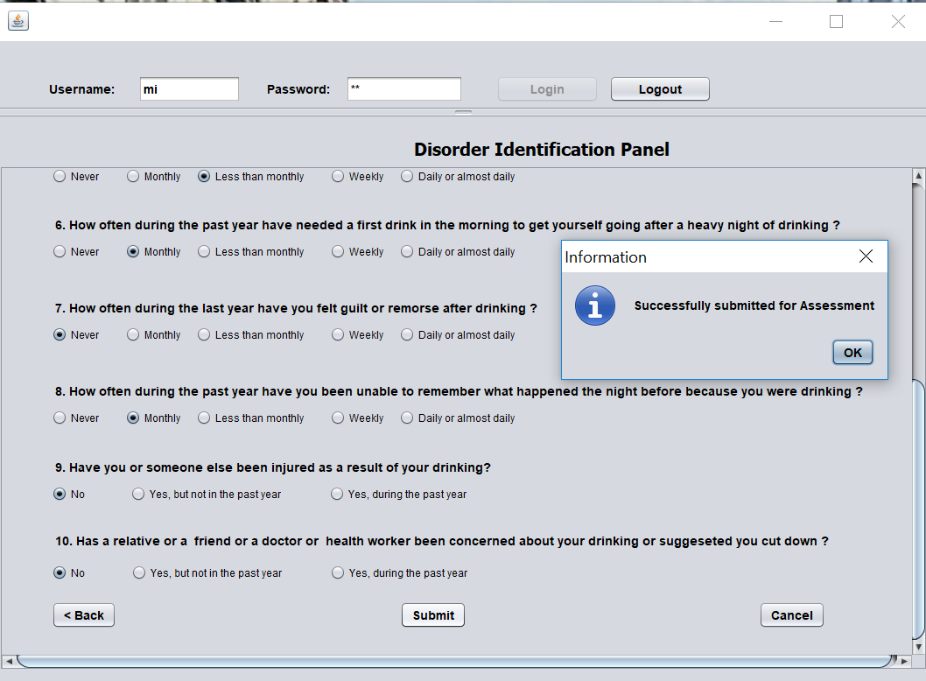
Patient Assessment

Slide 7
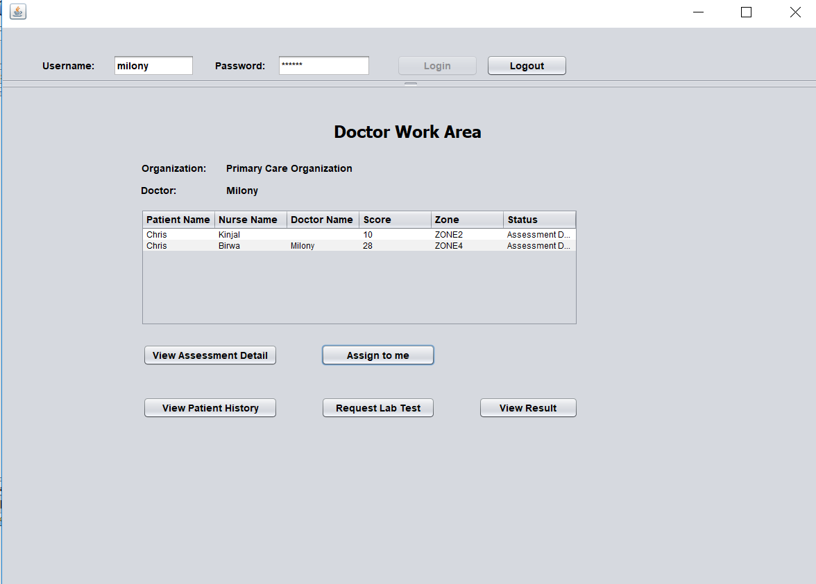
Doctor Assessment for Patient

Slide 8
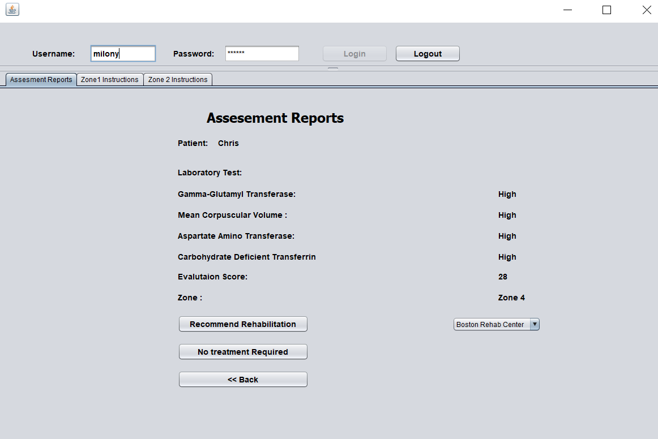
Recommendations provided by doctor

Slide 9
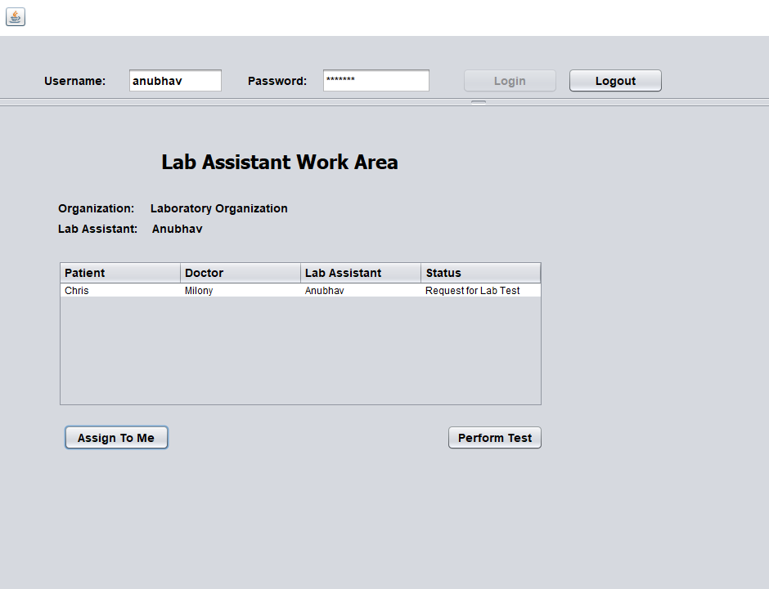
Lab Test Assessment for patient

Slide 10
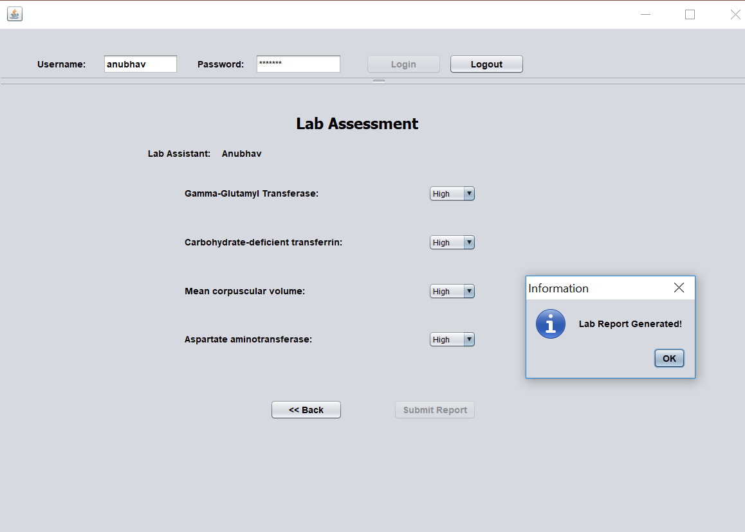

Slide 11
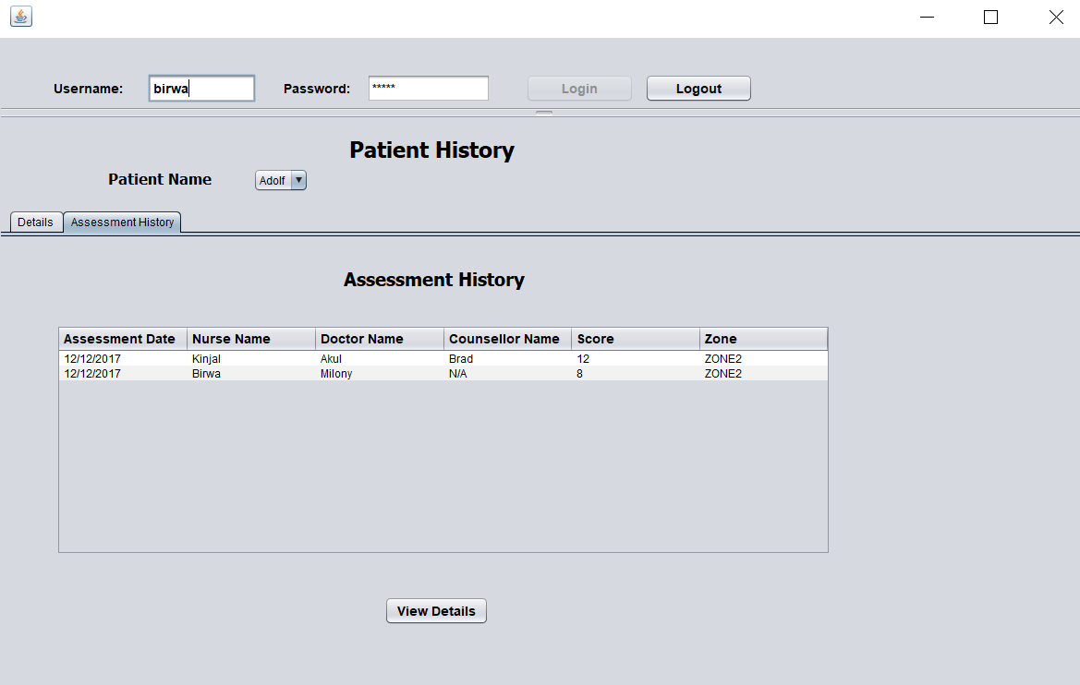
Keeping Track of Patient History

Slide 12
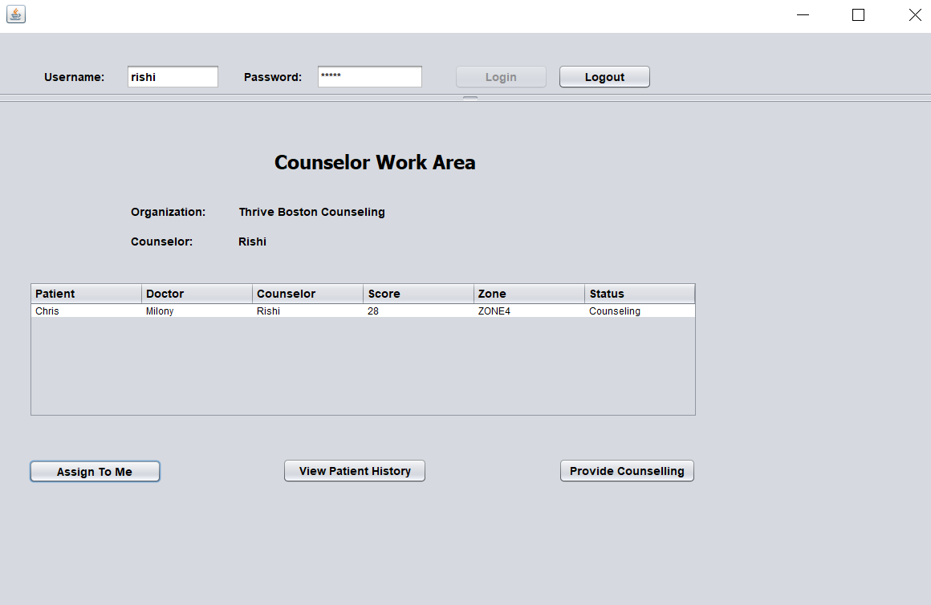
Counselor Assessment for Patient

Slide 13
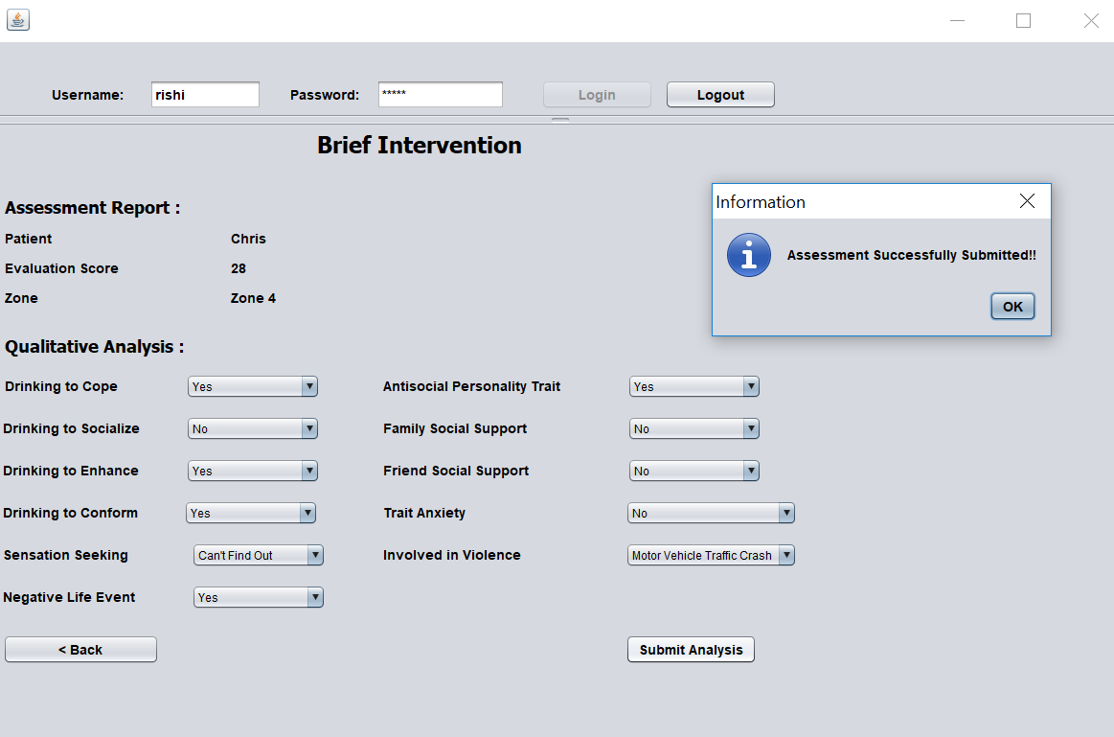

Slide 14
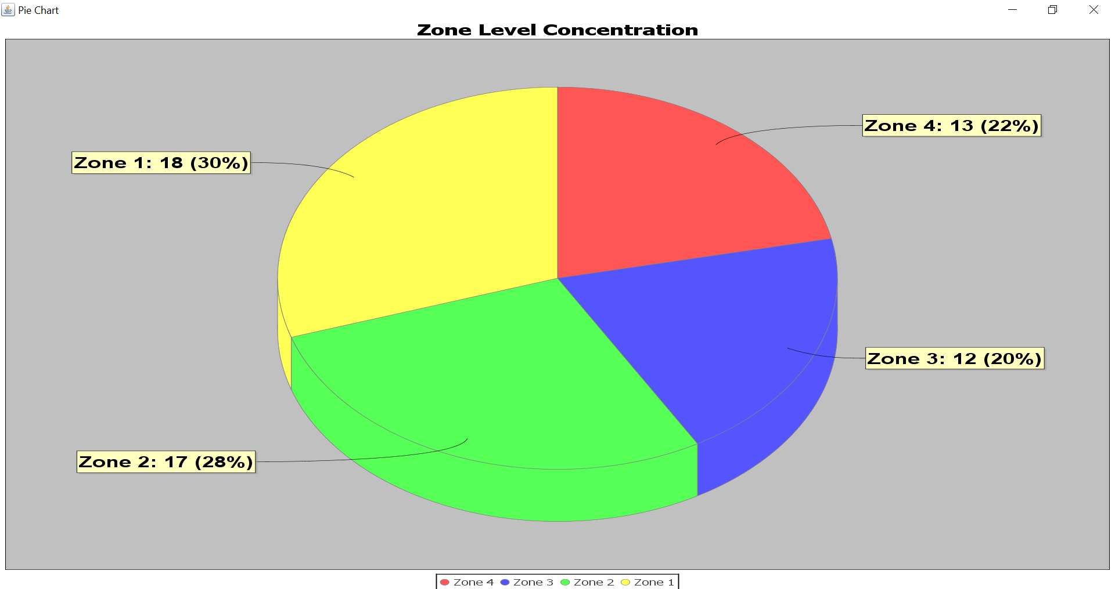
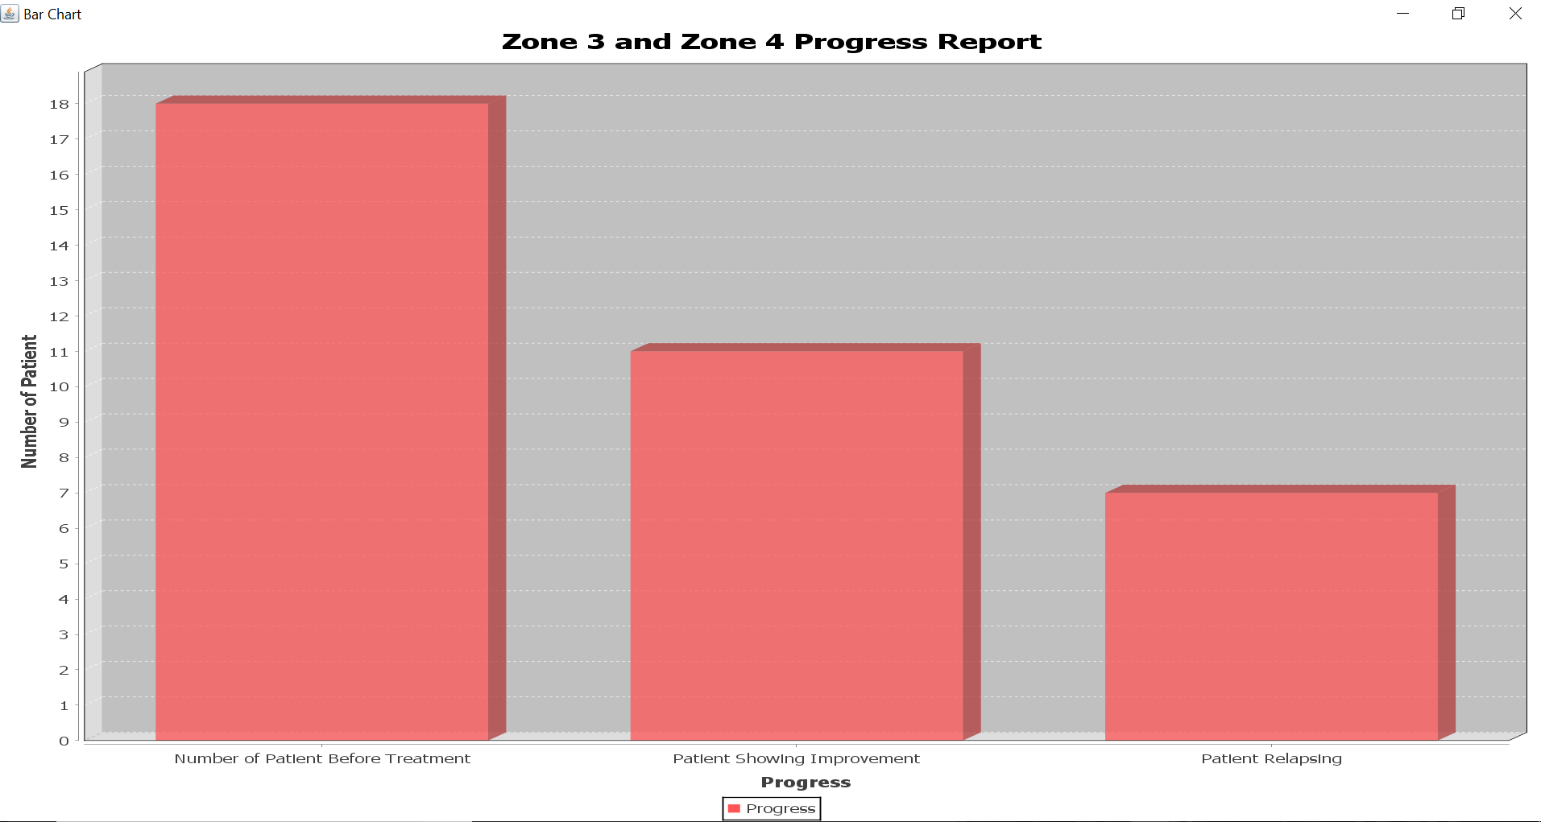
Report Generation at System Level

Slide 15
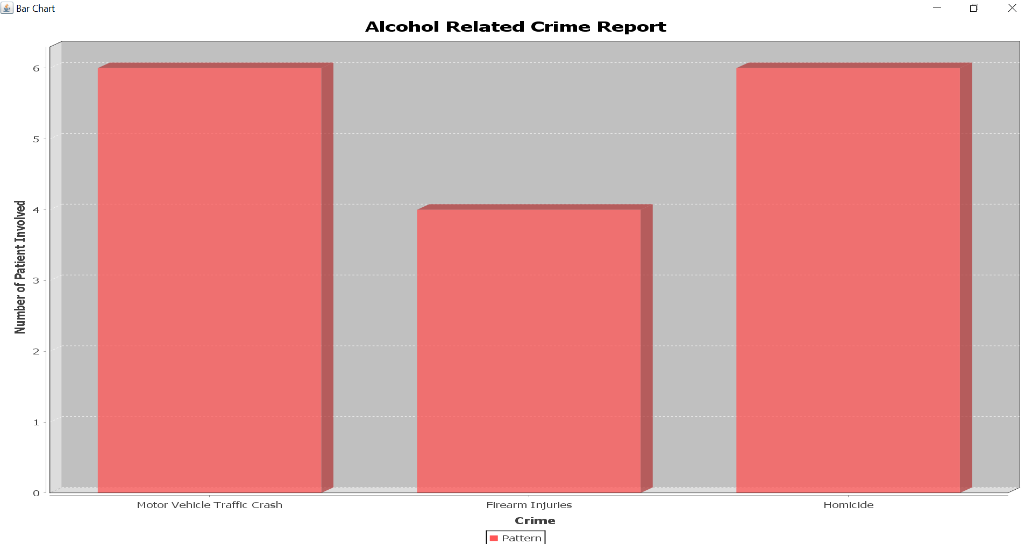
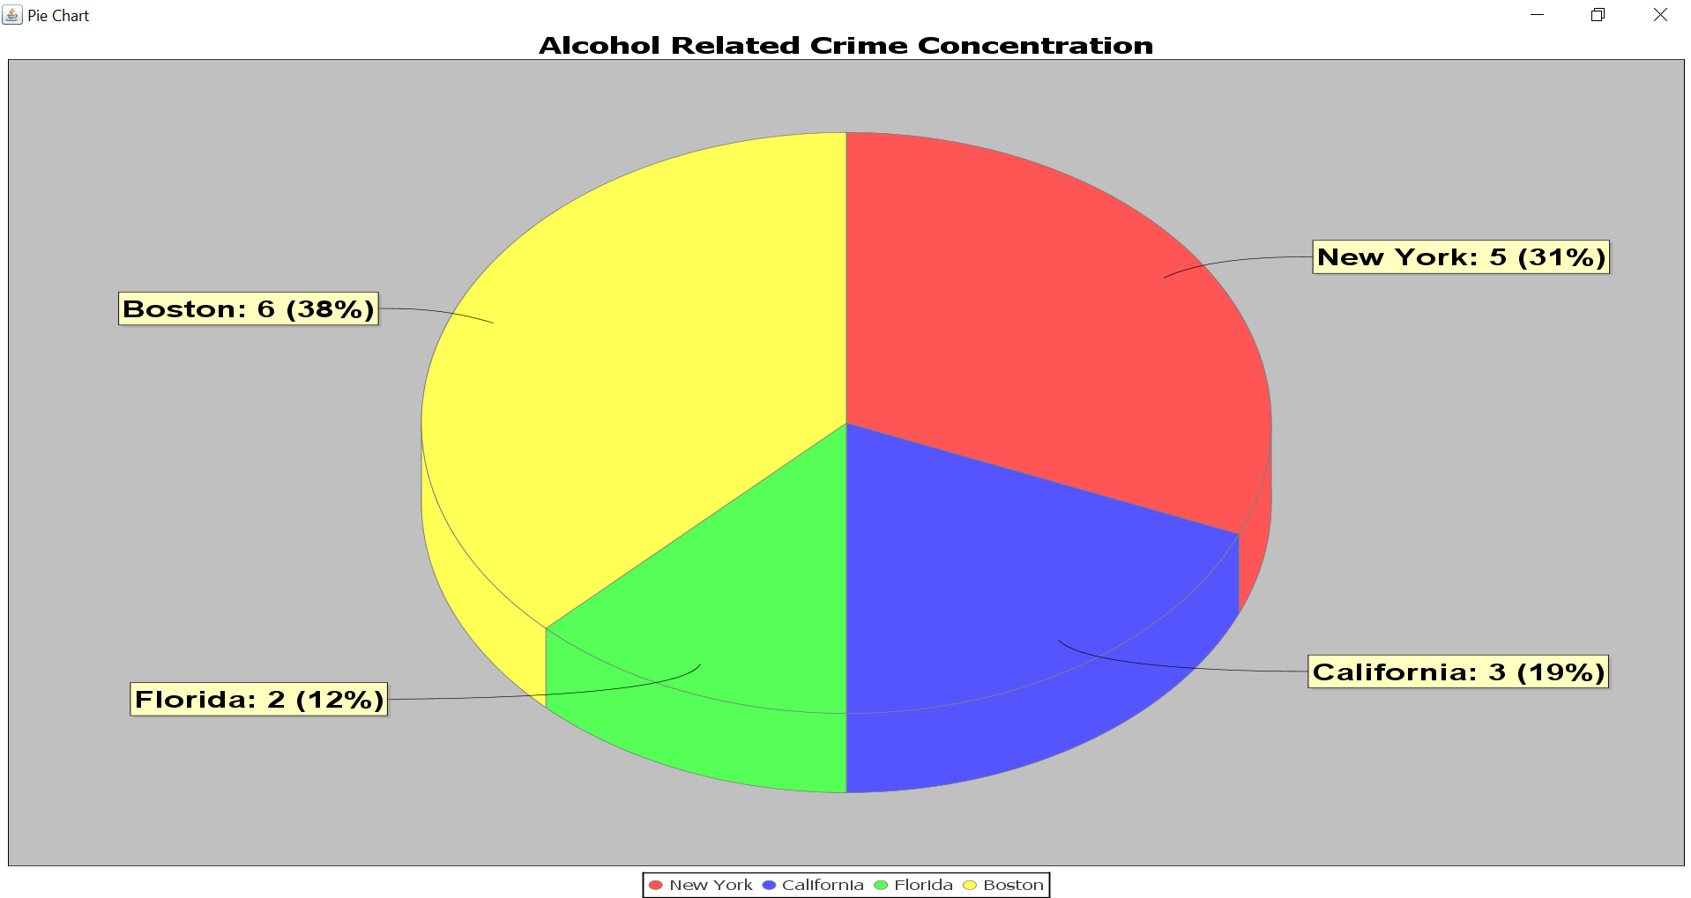

Slide 16
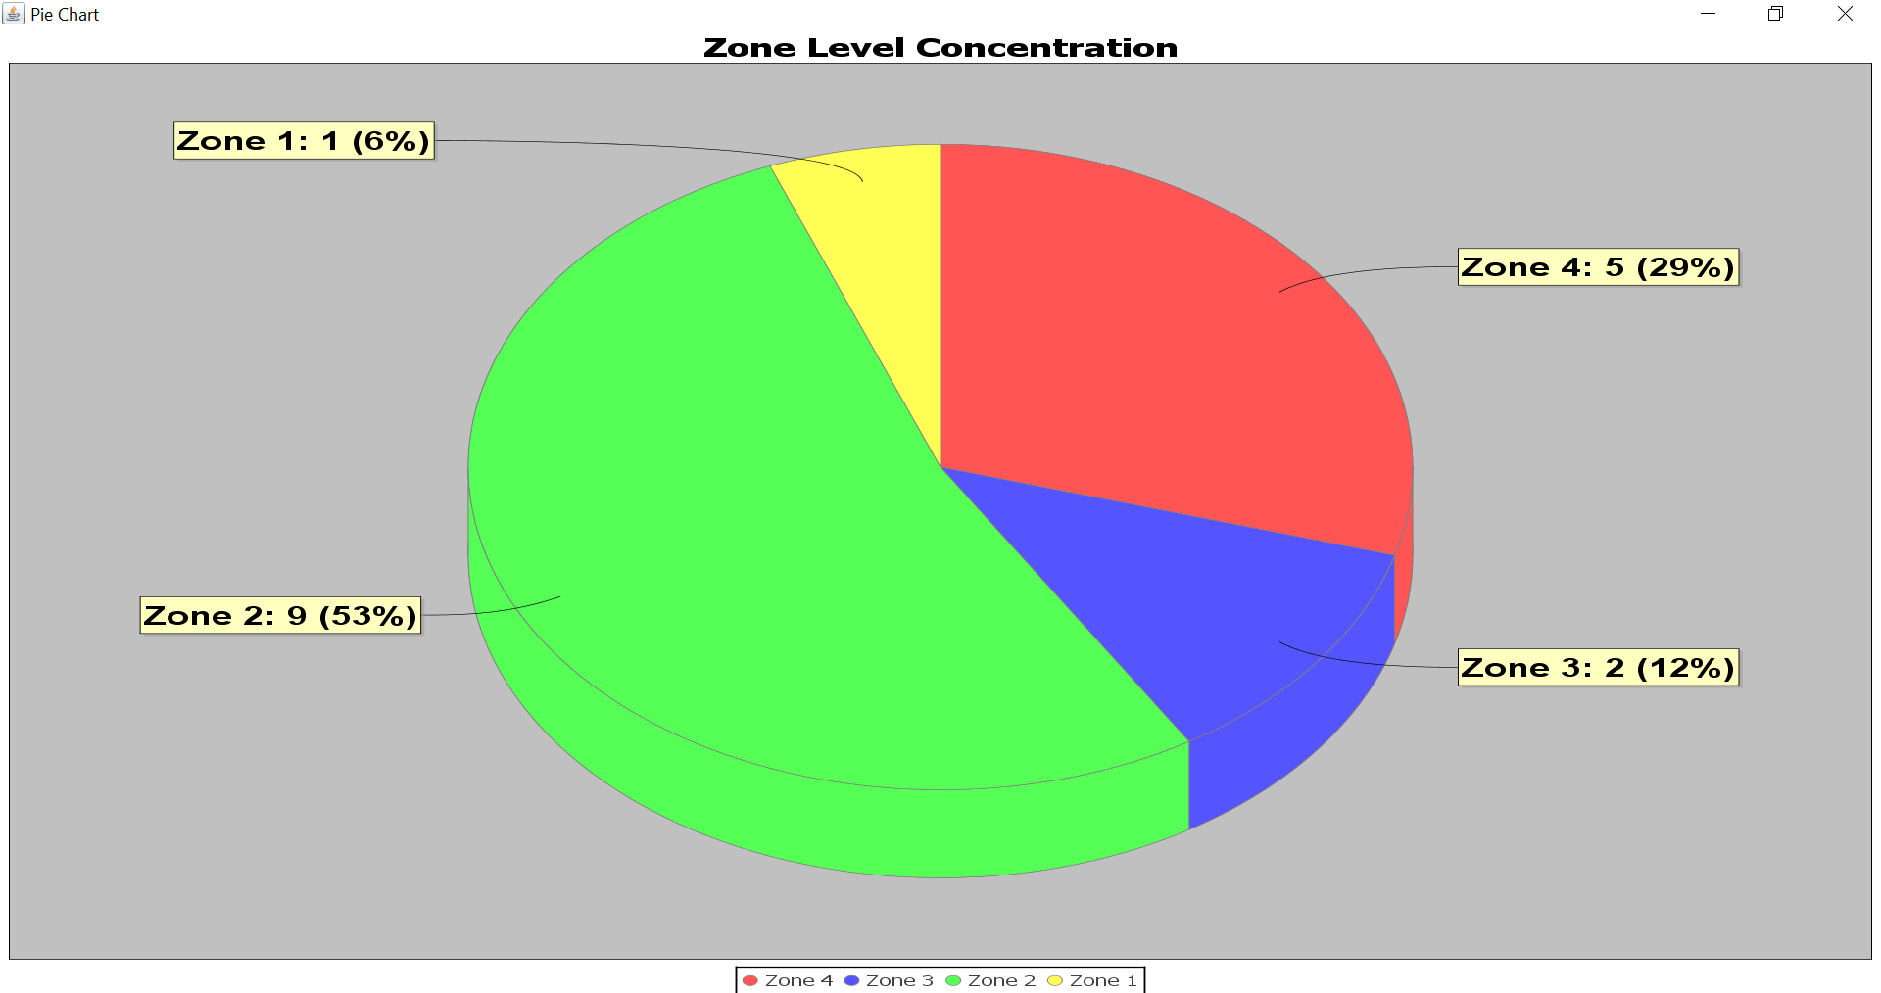
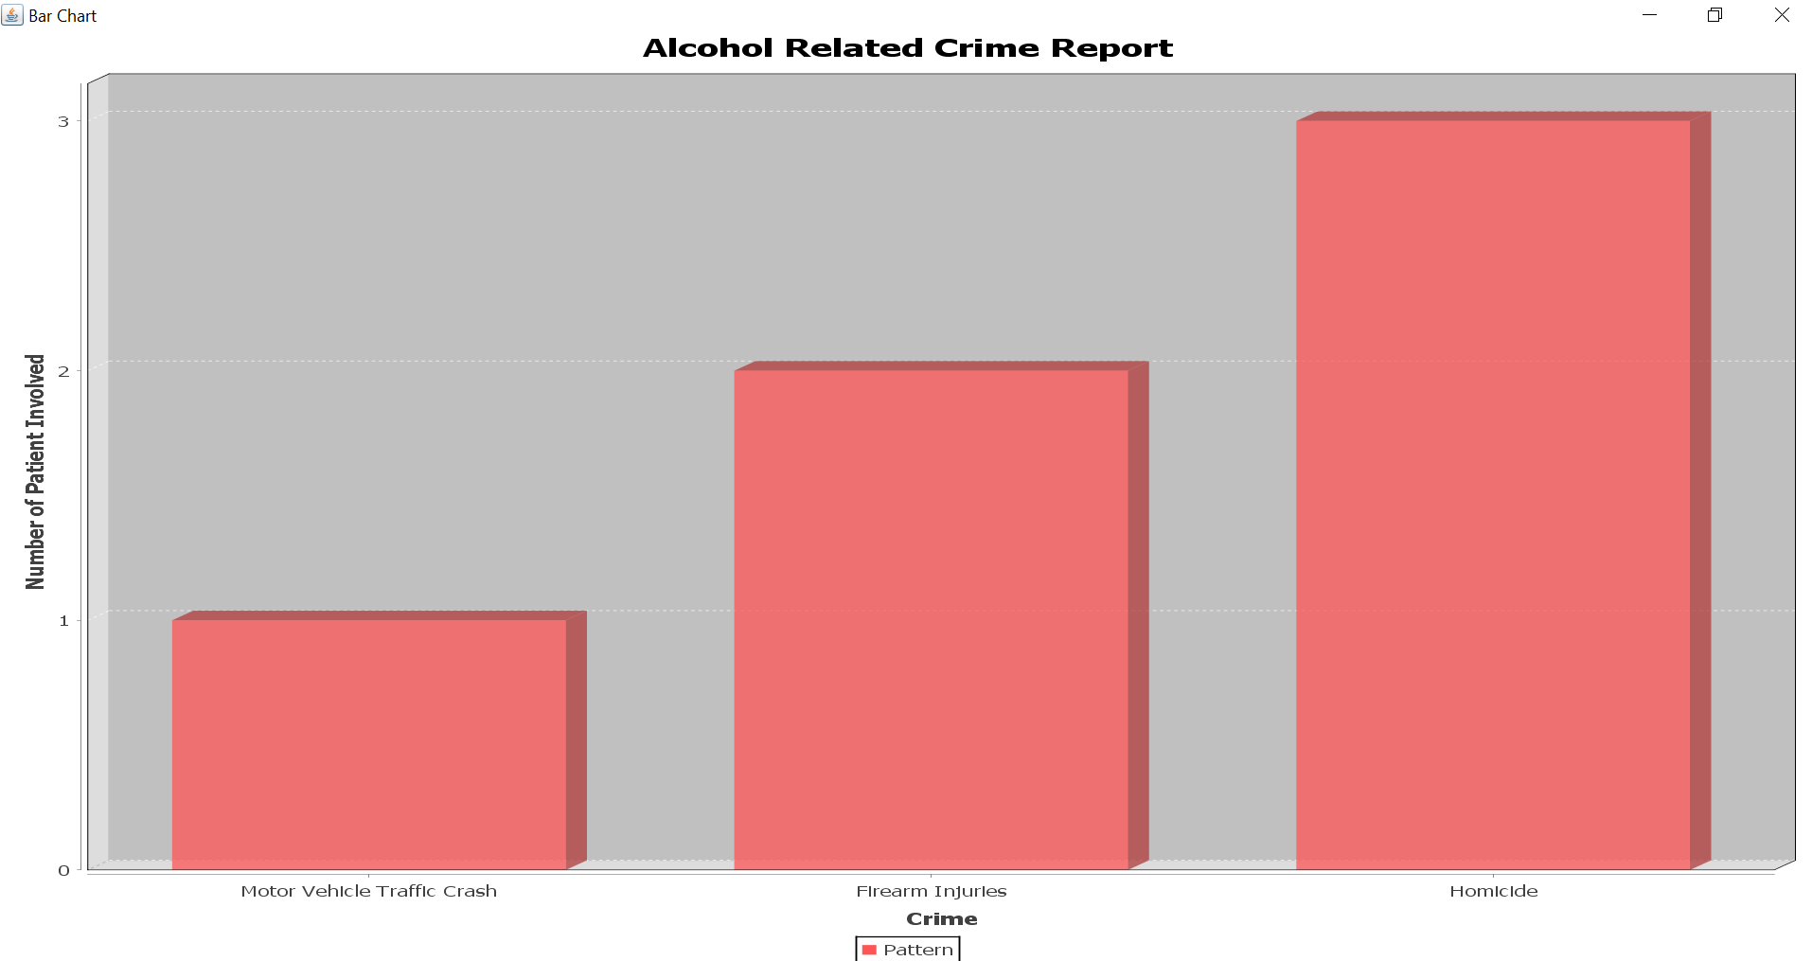
Report Generation at Network Level

Slide 17
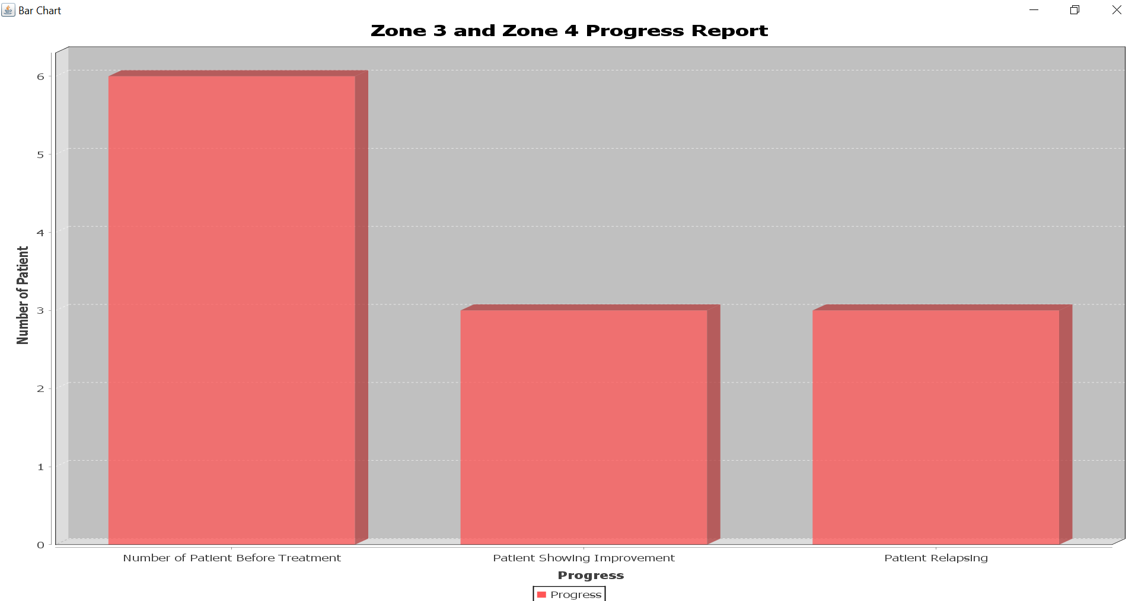
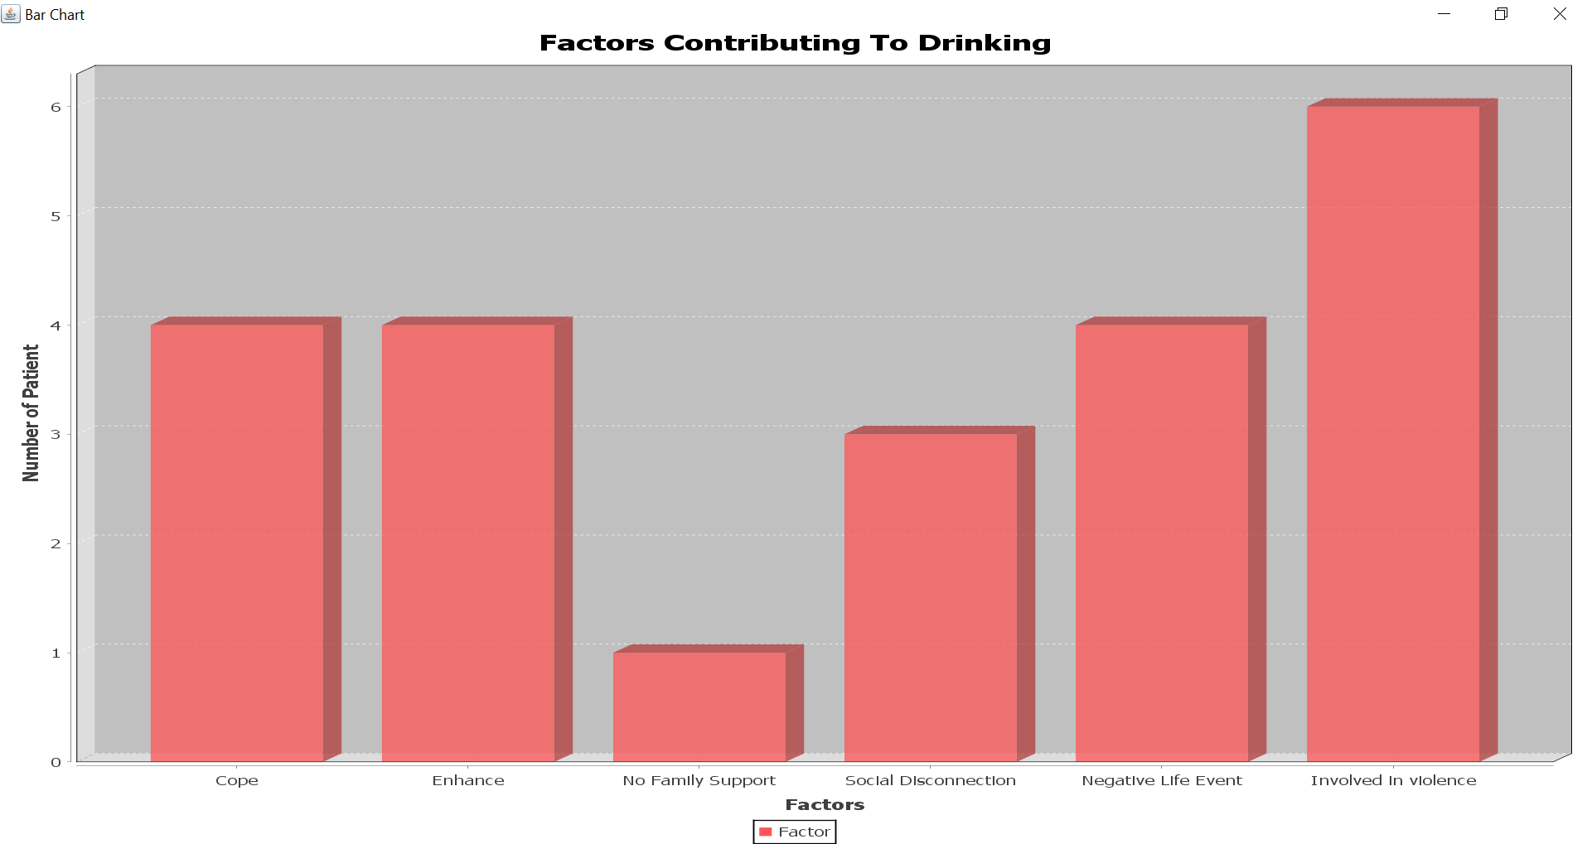

Slide 18
Actors
System Admin
Hospital Admin
Rehab Center Admin
Nurse
Doctor
Lab Assistant
Counselor
Health Inspector

Slide 19
Demo

Slide 20
Thank You

